Slide 1

Daniel Beckett, Khaled Khaled, Lauren May, Taylor Yee

Slide 2
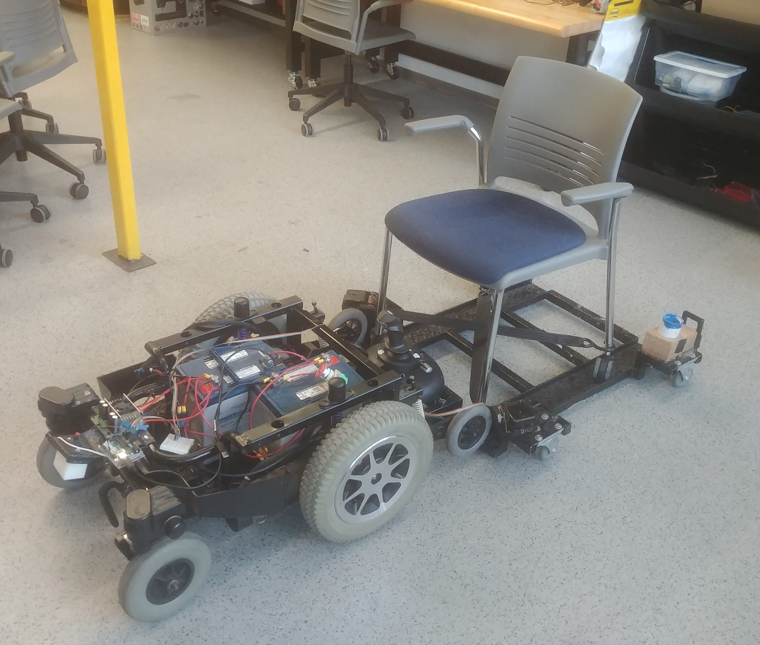
Introduction
Goal: to build an adaptable platform to provide help to children with mobility issues in their transition to drive electric powered wheelchairs (EPWs)
Clients:
Dr. Kyle Winfree, Assistant Professor at Northern Arizona University
Krista Branch, Physical Therapist (PT) in Flagstaff Unified School District (FUSD)
Khaled

Slide 3
Timeline and Responsibilities
Graphical User Input (GUI)
January - Researched on Methods for Implementation
February - User Interface Structure
March - User Interface Inputs & Filing Records
April - Testing and Debugging
Filing Records
Functionality
Prototype GUI with Authentication
Khaled
Khaled

Slide 4
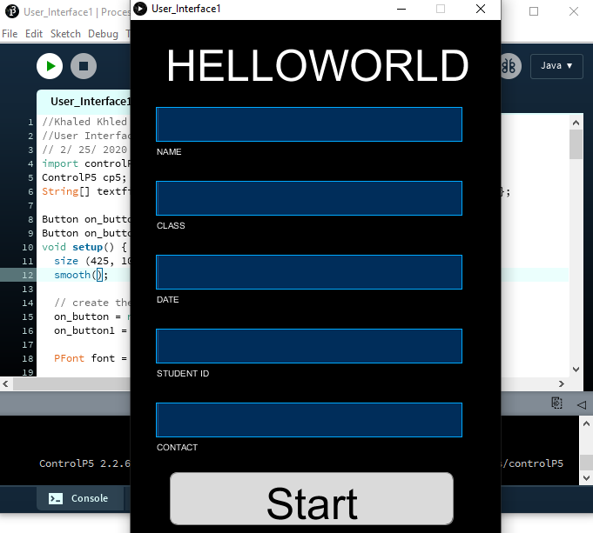
Graphical User Interface (GUI)
Title
Name, Class, Date..
Keeping records individually
User friendly
Functionality
Khaled
Khaled

Slide 5
Timeline and Responsibilities
Display Lidar Data in Real-Time on GUI
January - Research and Pseudocode Outline
February - Development of Code for the IR Sensors
March - Development of Lidar Sensing
Early April - Complete Bluetooth Module
Sensing Distances From Only 270° of the Lidar
Calculations for Velocity and Acceleration
Bluetooth Module to Communicate Between Arduino and Processing
Show Real-Time Data Simultaneously (IR) on GUI
Lauren
Lauren

Slide 6
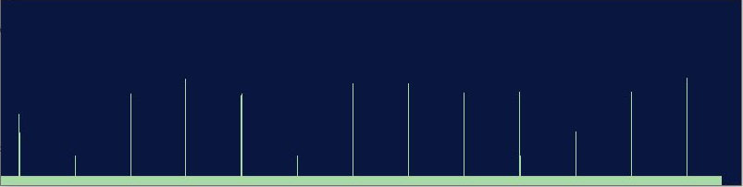
Sensors/Closed-Loop Control Development
Proximity and Lidar Sensors Will Send Information To:
Force Feedback Joystick
Display Real Time Data
Logging Data to Storage
Lauren
Lauren

Slide 7
Mobility Timeline and Responsibilities
Mobility
January - Basic Mobility Achieved
February - Sensor Responsive Force Feedback (FF) Joystick
March - Test Drive with IR Sensor Feedback
Early April - Improve Stability & Comfort
Replace Faulty Motor
Differential Drive Control Scheme
Replace Motor Driver
IR Sensors Influencing FF Joystick
Daniel
Daniel

Slide 8
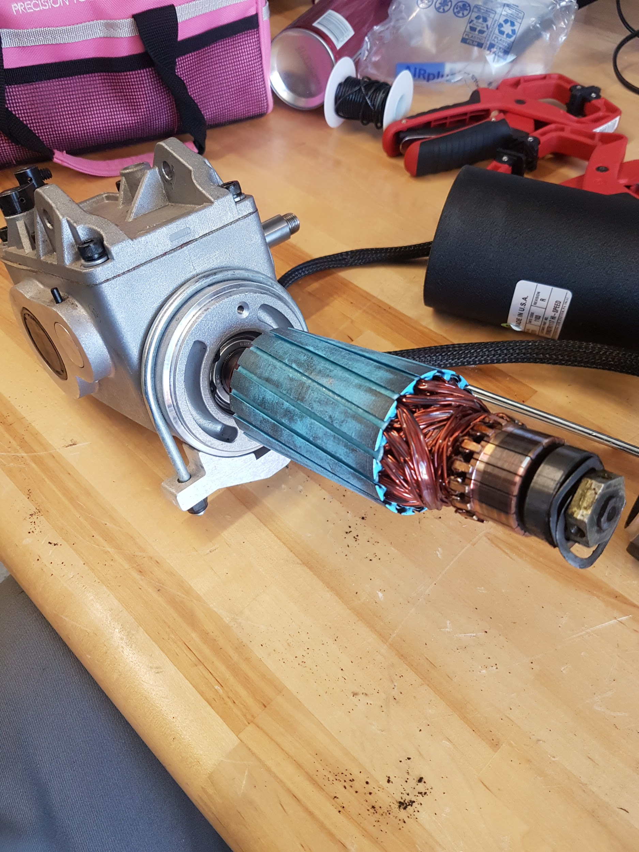
Plans for Mobility
Investigating Faulty Motor
Pursuing Replacement Motor
Install Sensors Onto Rig
Test FF Joystick While Driving
Daniel
Daniel
Notes:
On track!... Besides the whole driving thing
Test FF in real time with IR input

Slide 9
Power System Timeline and Responsibilities
Power System
January - Power Arduino Uno, Motor Driver, Joystick
February - Simultaneous Battery Eliminating Circuits (BEC)
March- Install BEC for All Electronics
Early April - Install Battery Charger
BEC’s Powered Individually
Tested Charging Battery
Installed 6 AWG Wire
Daniel
Daniel
Notes:
February -
Power force feedback motors, bluetooth module, electric brakes

Slide 10
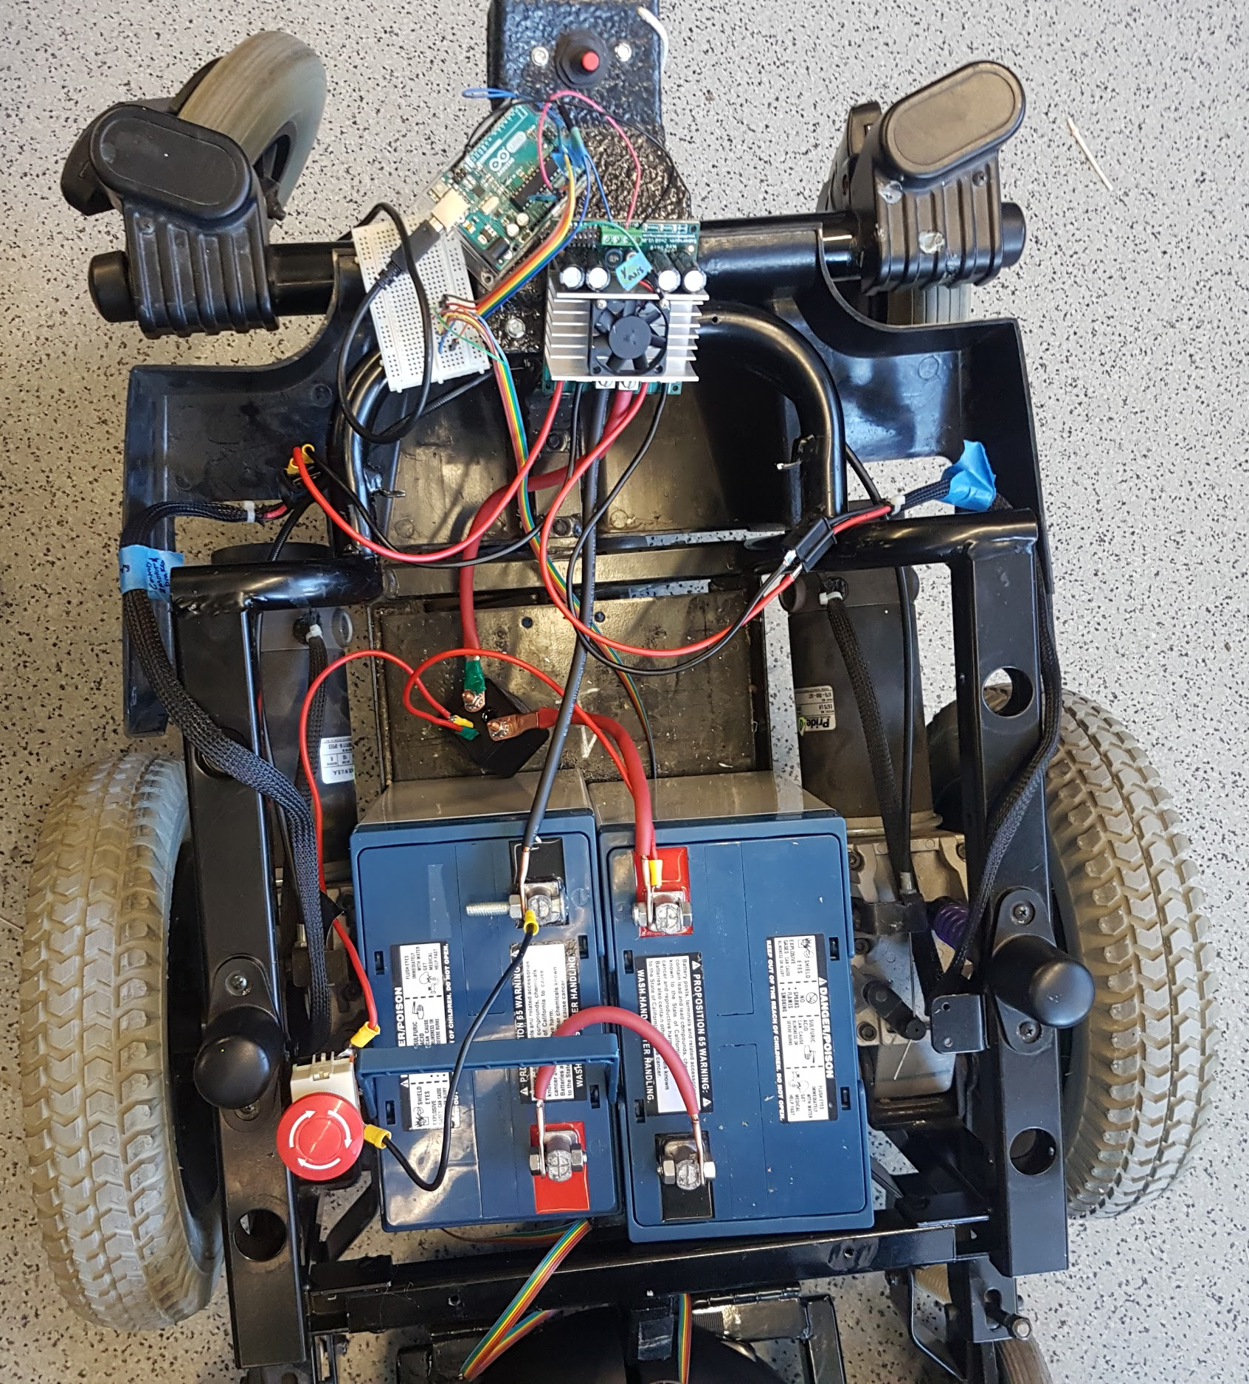
Plans for Power System
Combine BEC Circuits
Implement a Break in Main Circuit While Charging
Finalize Sensor Locations
Tidy Up Circuitry
Daniel
Daniel
Notes:
Currently tested BEC’s:
Force feedback joystick & motors
IR sensors
Bluetooth module
Electric brakes
Ahead of schedule
Still need to test with motors & LIDAR
Designed charging circuit
Upgraded wiring + Relay in killswitch
Created BEC

Slide 11
Timeline and Responsibilities
GUI and Data Logging
January: Handle User Inputs, Display Data
February: Log data, Handle Multiple Sessions
March: Wireless Transmission of Data, Test GUI With Full System
Early April: Refactoring and Field Testing
Real-Time Data Displayed Graphically
Develop Multiple Windows for GUI
Complete GUI Visually
Log Data Successfully to MicroSD Card
Choose When to Start and Stop Recording
Taylor
Taylor

Slide 12
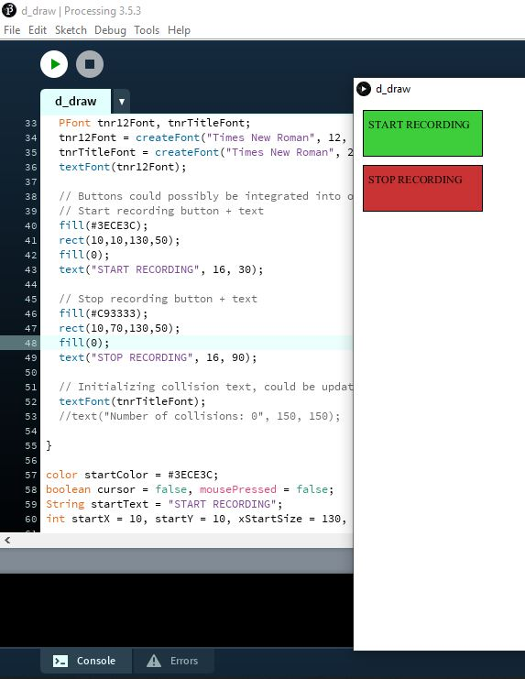
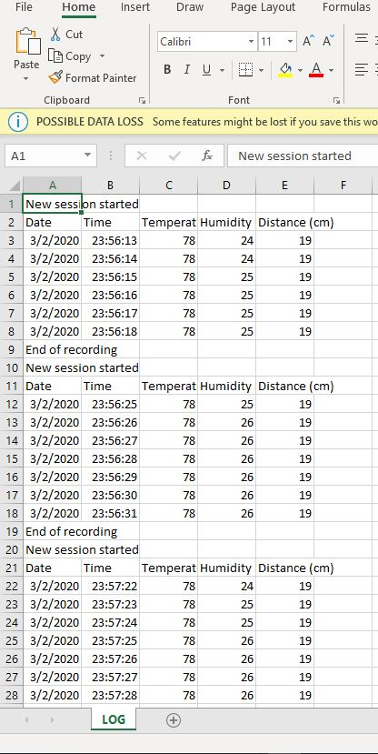
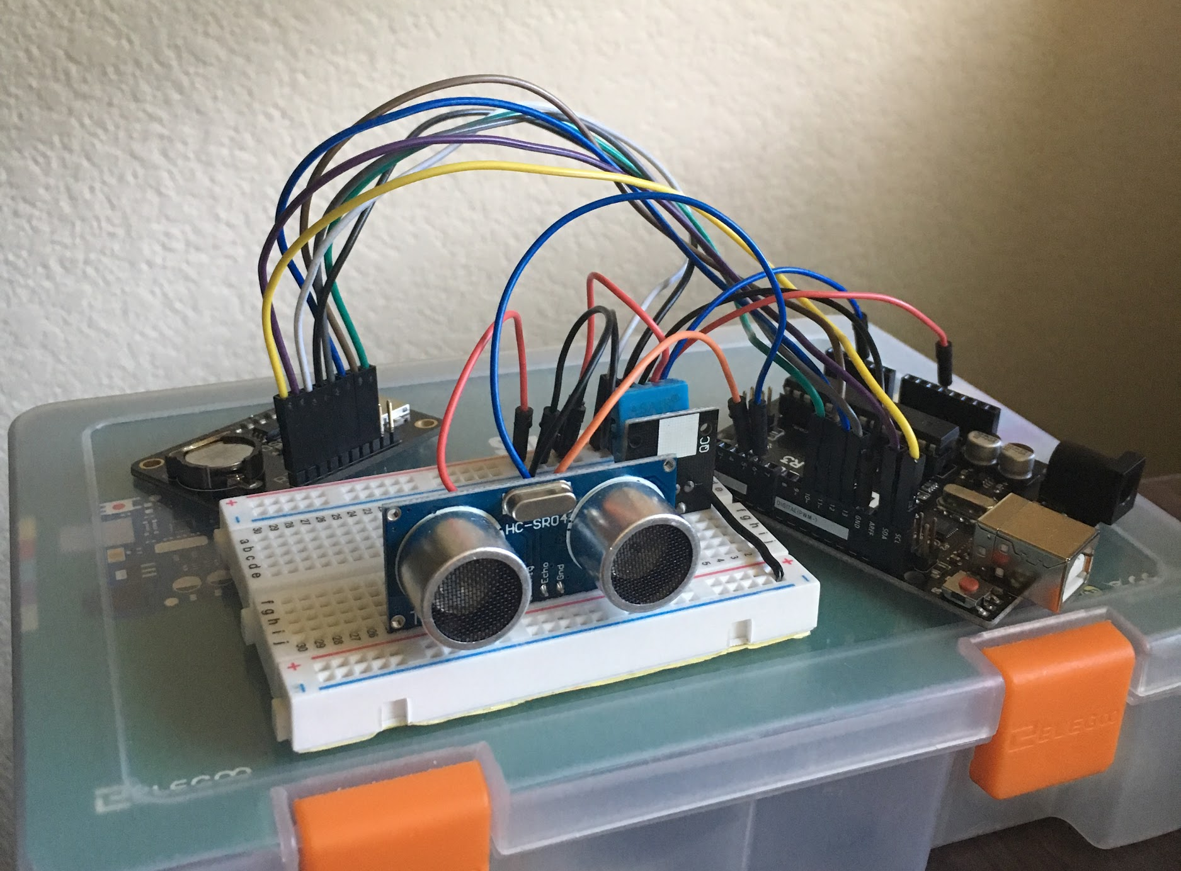
GUI and Data Logging development
Taylor
Taylor
Notes:
pictures make it look like i’m doing things lol

Slide 13
Conclusion
Mobility: Force feedback cannot be tested during operation until replacement motor arrives
Power System: Once mobile and IR sensors have been attached, BECs will be merged and installed permanently
GUI and Data Logging: Data links and communications established, logging data successfully, and basic GUI built. Now just a matter of expanding capabilities and visually refining displays
Lauren

Slide 14

Questions?

